Slide 1
Identified Significant Disproportionality – Now What?
2015 Leadership Conference
“All In: Achieving Results Together”
Tom Munk, IDC
Jody A Fields, PhD, University of Arkansas at Little Rock
Chris Thacker, IDC

Slide 2
Agenda
Review IDC’s “Addressing Success Gaps”
Review CEIS Requirements
Arkansas Example
New Jersey Example
Kentucky Example

Slide 3
Addressing Success Gaps
Equity, Inclusion, & Opportunity:

Slide 4
Why Equity, Inclusion and Opportunity: Addressing Success Gaps?
Significant Disproportionality (SD) or disproportionate representation (DR) is more than a special education issue.
Resolving SD/DR or improving SD/DR requires whole school/district approaches, not limited to special education
SD for discipline or identification is often the first of disparate outcomes for youth with disabilities throughout their lives.

Slide 5
What is a success gap?
Differences or “gaps” in a variety of educational factors and outcomes that affect the likelihood of educational success for some groups of students compared to their peers
Achievement
Identification and/or placement for special education
Suspension rates
College and career preparation
Graduation rates
Notes:
We will show you some sample data exemplifying these success gaps.

Slide 6

What are the results of success gaps?
Poor long-term outcomes for entire groups of students
Notes:
Before clicking on the answer to make it appear, ask the participants to share thoughts….pick only a couple of participants

Slide 7

Addressing Success Gaps White Paper
Notes:
We developed a tool to help states, districts, and schools look at the services and supports they were providing for all students, help them to identify areas where there were gaps (achievement gaps, opportunity gaps, gaps in other areas) for other subgroups of students compared to everyone else or each other. It’s to use to assess the degree to which their systems are being responsive to the diverse needs of all of their students.
Purpose of the Success Gaps documents: The “Success Gaps” documents are designed for schools and districts to use to assess the degree to which their systems are being responsive to the diverse needs of all of their students.
The “Success Gaps” documents are also designed to help districts/schools identify and then plan to address some of the systemic, contributing factors that result in over-representation of minority students in special education.
Regional Resource Center Program
Nancy O’Hara, Lead, RRCP Disproportionality Priority Team
Cesar D’Agord, WRRC, John Inglish, WRRC, Kristin Reedy, NERRC, Susan DuRant, SERRC
Other TA Centers
Darren Woodruff , National RTI Center@AIR and Tom Munk, DAC/IDC
US ED, Office of Special Education Programs
Perry Williams, Grace Duran, Jennifer Finch, Dave Guardino
Additional Reviewers
State staff in Georgia, Michigan, Rhode Island, Louisiana, New jersey
Regional Equity Centers

Slide 8
Intended Audiences
State departments of education
Local school districts
Schools
TA providers, professional developers, & consultants working with districts and schools
Other stakeholders concerned about equity issues in schools
General Ed. and Special Ed.

Slide 9
To address success gaps…
… look closely at equity, inclusion, and opportunity for children in the affected groups
Notes:
Polling question (select all that apply)
In your school or district setting who are the affected subgroups?
Low SES
Students with disabilities
English Language Learners
Student who are white
Students who are black
Students who are Hispanic
Other

Slide 10

Structure of the Document(s)
White paper: Introductory research brief
Self-assessment rubric

Slide 11
Investigate the root causes of your success gaps
Have you implemented these five elements?
Data-based decision making
Cultural responsiveness
High-quality core instructional program
Universal screening and progress monitoring
Evidence-based interventions and supports
Notes:
Research shows that paying attention to these five factors can assist districts and schools to achieve more equitable success among all subgroups. Each of these sections are supported by research in the white paper. Many of the documents/articles cited are great resources for more detailed information.

Slide 12
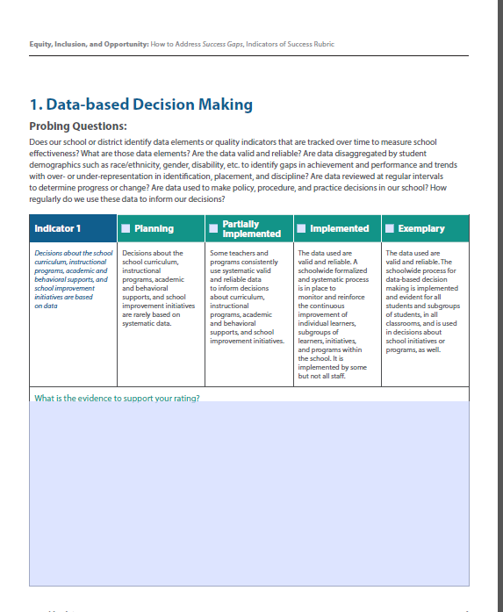
Rubric Organization
Content Area
Rubric rating scale
Probing Questions
Indicator
Text box to describe evidence to support rating of the team
Notes:
Lets start with the set up of the rubric. Each section or content area is set this way. Many of the content areas have more than one indicator and therefore are on multiple pages.
The scale is is the same across each area, Planning, Partially Implemented, Implemented, Exemplary, although described below the scale in the description of the indicator.

Slide 13

Data-Based Decision Making
Use disaggregated data for decisions about
Curriculum and instructional programs
Academic and behavioral supports
Are policies and procedures effective?
Make decisions about student interventions using multiple data sources, including
Screening
Progress monitoring
Formative and summative evaluation data

Slide 14

Cultural Responsiveness
Recognize diversity across student ethnicity, language, and socio-economic status
Provide training and resources so teachers can meet the linguistic needs of all students
Include parents from all backgrounds in discussions about the school and about their children’s progress
Notes:
Note about parents included in each section!

Slide 15

Core Instructional Program
Rigorous, consistent, and well-articulated K-12 instructional program, aligned with standards, delivered with fidelity
Effective differentiation in the core curriculum
Universal design for learning
Informing parents in their native or home language about differentiation

Slide 16

Assessment
Valid universal screening
Progress monitoring for all students
Informing parents in their native or home language about results

Slide 17
Evidence-Based Interventions and Supports
Implemented with fidelity
Instructional
Behavioral
Such as Positive Behavioral Supports or Restorative Justice
Tiered response protocols, not zero tolerance
Informing parents in their native or home language about interventions and responses
Notes:
What are we missing? Are there other areas you would include?
What do you think? In your school or district, there is room for improvement in:
Data based decision making
Cultural responsiveness
Core instructional program
Assessment
Evidence based interventions and support

Slide 18

Addressing Success Gaps Rubric
Notes:
Using the Self-Assessment Rubric, there are four suggested possible ratings:
Planning,
partially implemented,
fully implemented or
exemplary.
Probing questions are provided to assist the team in determining where they are at this point.
Document what evidence exists to support the rating that the team selects.

Slide 19
To address success gaps… the plan of action
Step One - Recognize the need for change in your school’s or district’s current practices and policies because you have identified a group of students who are experiencing success gaps.
Step Two - Identify the root causes of the problem.
Step Three - Make the changes that address those root causes.
Notes:
Polling question (select all that apply)
In your school or district setting who are the affected subgroups?
Low SES
Students with disabilities
English Language Learners
Student who are white
Students who are black
Students who are Hispanic
Other

Slide 20
How to Address Success Gaps
Form a team
Study the data
Conduct a self-assessment
Provide evidence
Consider the students first
Ensure equitable participation
Develop a plan of action

Slide 21


Success Gaps and Root Causes
36.50% Graduation Gap
OSS >10 Days
Exclusion Rate Is 4 Times Greater for Black SWD Than White SWD
Success Gaps
Identification Rate for Male Students Is Twice the Rate for Female Students
8% to 14% Gap on Reading assessment
MID Identification Rate for Black Students Is Twice the Rate for White Students
16% to 28% Gap on Math assessment
4.3% Gap More than 15 days absent
Data-based
Decision Making?
Cultural Responsiveness?
Evidence–based Interventions?
Universal Screening?
Root Causes
(EIO)
Progress Monitoring?
Instructional Program?

Slide 22
Not so easy
Not So Easy
“Equity, inclusion and opportunity for all students is an important goal, but one that is not easily achieved.”
(EIO)

Slide 23
Coordinated early intervening services (CEIS)

Slide 24
CEIS
Why CEIS?
To allow—or, in instances of significant disproportionality, to require—LEAs to use IDEA funds for at-risk students in hopes of providing interventions and supports that will reduce the inappropriate referral and identification of students into special education.

Slide 25
CEIS
Described in 34 CFR §300.226
LEA may use up to 15% of IDEA funds for CEIS
Less any amount reduced pursuant to §300.205
To be used on students in K-12, with a particular emphasis on K-3
Allowed activities:
Professional development
Educational and behavioral evaluations, services, and supports
Notes:
a) General. An LEA may not use more than 15 percent of the amount the LEA receives under Part B of the Act for any fiscal year, less any amount reduced by the LEA pursuant to §300.205, if any, in combination with other amounts (which may include amounts other than education funds), to develop and implement coordinated, early intervening services, which may include interagency financing structures, for students in kindergarten through grade 12 (with a particular emphasis on students in kindergarten through grade three) who are not currently identified as needing special education or related services, but who need additional academic and behavioral support to succeed in a general education environment. (See appendix D for examples of how §300.205(d), regarding local maintenance of effort, and §300.226(a) affect one another.)
(b) Activities. In implementing coordinated, early intervening services under this section, an LEA may carry out activities that include—
(1) Professional development (which may be provided by entities other than LEAs) for teachers and other school staff to enable such personnel to deliver scientifically based academic and behavioral interventions, including scientifically based literacy instruction, and, where appropriate, instruction on the use of adaptive and instructional software; and
(2) Providing educational and behavioral evaluations, services, and supports, including scientifically based literacy instruction.
(c) Construction. Nothing in this section shall be construed to either limit or create a right to FAPE under Part B of the Act or to delay appropriate evaluation of a child suspected of having a disability.
(d) Reporting. Each LEA that develops and maintains coordinated, early intervening services under this section must annually report to the SEA on—
(1) The number of children served under this section who received early intervening services; and
(2) The number of children served under this section who received early intervening services and subsequently receive special education and related services under Part B of the Act during the preceding two year period.
(e) Coordination with ESEA. Funds made available to carry out this section may be used to carry out coordinated, early intervening services aligned with activities funded by, and carried out under the ESEA if those funds are used to supplement, and not supplant, funds made available under the ESEA for the activities and services assisted under this section.
(Approved by the Office of Management and Budget under control number 1820-0600)
(Authority: 20 U.S.C. 1413(f))

Slide 26
CEIS (2)
LEA Reporting
Annual
Number of children served
Number of children served during preceding two-year period and who subsequently receive special education and related services
Coordination with ESEA:
Must supplement, not supplant
Notes:
a) General. An LEA may not use more than 15 percent of the amount the LEA receives under Part B of the Act for any fiscal year, less any amount reduced by the LEA pursuant to §300.205, if any, in combination with other amounts (which may include amounts other than education funds), to develop and implement coordinated, early intervening services, which may include interagency financing structures, for students in kindergarten through grade 12 (with a particular emphasis on students in kindergarten through grade three) who are not currently identified as needing special education or related services, but who need additional academic and behavioral support to succeed in a general education environment. (See appendix D for examples of how §300.205(d), regarding local maintenance of effort, and §300.226(a) affect one another.)
(b) Activities. In implementing coordinated, early intervening services under this section, an LEA may carry out activities that include—
(1) Professional development (which may be provided by entities other than LEAs) for teachers and other school staff to enable such personnel to deliver scientifically based academic and behavioral interventions, including scientifically based literacy instruction, and, where appropriate, instruction on the use of adaptive and instructional software; and
(2) Providing educational and behavioral evaluations, services, and supports, including scientifically based literacy instruction.
(c) Construction. Nothing in this section shall be construed to either limit or create a right to FAPE under Part B of the Act or to delay appropriate evaluation of a child suspected of having a disability.
(d) Reporting. Each LEA that develops and maintains coordinated, early intervening services under this section must annually report to the SEA on—
(1) The number of children served under this section who received early intervening services; and
(2) The number of children served under this section who received early intervening services and subsequently receive special education and related services under Part B of the Act during the preceding two year period.
(e) Coordination with ESEA. Funds made available to carry out this section may be used to carry out coordinated, early intervening services aligned with activities funded by, and carried out under the ESEA if those funds are used to supplement, and not supplant, funds made available under the ESEA for the activities and services assisted under this section.
(Approved by the Office of Management and Budget under control number 1820-0600)
(Authority: 20 U.S.C. 1413(f))

Slide 27
Arkansas example

Slide 28
Arkansas’ Significant Disproportionality: Identification
Risk ratios methodology
Weighted RR vs RR; whichever is smaller
Three consecutive years with risk ratios greater than 4
Risk ratio of the racial/ethnic group will be considered invalid and be excluded if the
District enrollment of a racial/ethnic group is less than 5% or more than 95%; or
Number of students in the district’s special education child count is equal to or less than 40.

Slide 29
Arkansas’ Significant Disproportionality by Disability Category
Risk ratios methodology
Weighted RR vs RR; whichever is smaller
Three consecutive years with risk ratios greater than 4
Risk ratio of the racial/ethnic group will be considered invalid and be excluded if the
District enrollment of a racial/ethnic group is less than 5%
Number of students in the district’s special education child count is equal to or less than 40.

Slide 30
Arkansas’ Significant Disproportionality: LRE
Risk ratios methodology
Weighted RR vs RR; whichever is smaller
Three consecutive years with risk ratios greater than 4
Included Environments
40-79% in the regular classroom (RR)
<40% in the regular classroom (SC)
Day School

Slide 31
Arkansas’ Significant Disproportionality: LRE (2)
Risk ratio of the racial/ethnic group will be considered invalid and be excluded if the
District enrollment of a racial/ethnic group is less than 5%
Number of students in the district’s special education child count is equal to or less than 40.

Slide 32
Arkansas’ Significant Disproportionality
Discipline
Compared to LEA
Percentage point difference greater than 4 for three consecutive years
Secondary Criteria: The composition difference will be excluded
If the Child Count is below 40 or
If the Child Count of the race is group below 10
Possible change
Exclude if there are fewer than 2 students with >10 days OSS/Expulsion

Slide 33
CEIS Requirements
CEIS: 3 LEAs identified in 2014/15
Discipline (1st year)
W-OHI (3rd year)
B-ID (multi-years)
Completed a Self-Assessment as a review of policies, procedures, and practices
Required to submit a CEIS Plan

Slide 34
Success Gaps Rubric
All 3 LEAs attended training in November on the Success Gaps Rubric
Team sizes ranged from 2 to 8 members
Required to completed the Rubric and submitted to their state area supervisor for review

Slide 35
Success Gaps Rubric Feedback
Special education staff had to work with other district staff to complete the Rubric
Gave everyone a better understanding
Forced the districts to address things they have been avoiding.
Looked at discipline in the manner they examined assessment

Slide 36
Blytheville School District
Intensive ISS program was piloted in Blytheville Middle School
Although piloted there, many of the attributes and strategies have been implemented in the Blytheville Public School District as a whole
Evidence to this fact are the following data slides

Slide 37
Discipline Data for Blytheville Middle School
2013-2014
2014-2015
2,045.50 Student Days of Out-of-School Suspension
1,249 Student Days of Out-of-School Suspension
This is a 38.94% reduction

Slide 38
Now What?
Use of Success Gaps Rubric as a means to identify practices that may contribute to disproportionality
Have all LEAs offering CEIS (required and voluntary) complete the Success Gaps Rubric

Slide 39
Now What? (2)
Modify the rubric to get more information.
Similar to what South Carolina did for their SSIP
Responses for each probing questions

Slide 40
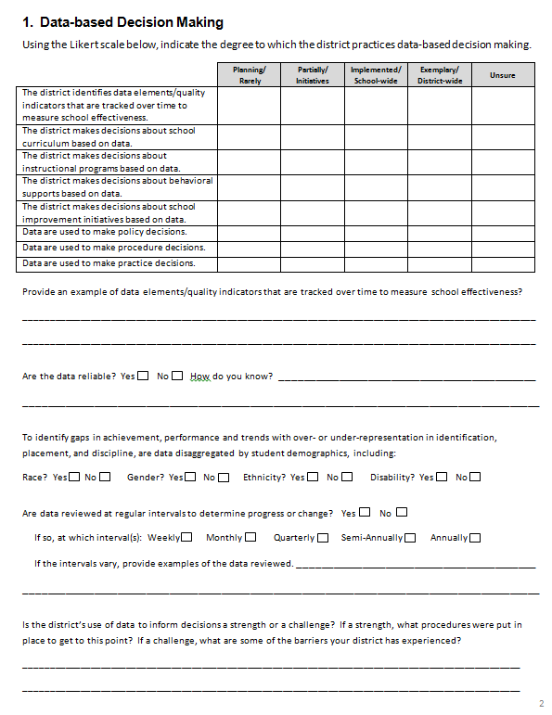
Data Based Decision Making Rubric

Slide 41
kentucky example

Slide 42

IDC TA to the Kentucky Department of Education Part B Program
Identification of a need for assistance and State Liaison contact with the State Director
Establishing time for a conference call and the discussion of needs
Follow-up planning and assignments
Creating the products
Using the products (Outcomes)

Slide 43

Call to Discuss Needs
Established goals for the work
To have a product/resources that can be used as needed
To reduce fiscal burden on LEAs
To establish protocol for collecting data on LEAs volunteering to use 15% of their Part B funds for CEIS
Identified individuals to do the work

Slide 44

Finding Information
Contact with IDC MOE/CEIS workgroup leads
Recommendation to enroll in
the IDC Learning Community

Slide 45
Follow-up Planning and Assignments
Meeting with KDE staff to determine agenda assignments
History/Background of CEIS
Calculating Significant Disproportionality
Tracking CEIS Services to Students
Impact of CEIS on MOE Reduction
Work to develop segment presentations
Review content

Slide 46
Presentation
Film each session presentation
Schedule webinar with CEIS identified LEAS
Host presentation w/ live narration and Q and A
Make presentations of each section available for viewing on-line

Slide 47
Outcomes
Video segments of requirements, data collection processes, etc.
Webinar for LEAs required to use 15% of Part B funds for CEIS and any LEA volunteering to use 15% of funds for CEIS (who want to participate)

Slide 48

Intended Outcomes
Q and A document
Establish practices for tracking LEAs voluntarily using 15% of Part B funding for CEIS

Slide 49
Discussion
Challenges associated with identifying LEAs with significant disproportionality
Challenges associate with helping LEAs once they have been identified with significant disproportionality implement including the requirement to implement CEIS
Successful practices they have used to help LEAs identified with significant disproportionality.

Slide 50
IDC Web Resources
Visit the IDC website at: http://ideadata.org/
Follow us on Twitter: https://twitter.com/ideadatacenter

Slide 51



Author Information
The contents of this presentation were developed under a grant from the U.S. Department of Education, #H373Y130002. However, the contents do not necessarily represent the policy of the Department of Education, and you should not assume endorsement by the Federal Government.
Project Officers: Richelle Davis and Meredith Miceli

