Slide 1
What Data Can Tell Us – and What It Can’t
2015 Leadership Conference
“All In: Achieving Results Together”
How to be sure we know
what our data means
Dana Manning, University of Kentucky HDI
Tom Munk, IDC & Westat
Debbie Cate, IDC at FPG, UNC Chapel Hill
Siobhan Colgan, IDC at FPG, UNC Chapel Hill

Slide 2
Outline of Session
Overview of critical issues in interpreting data
Indicator examples
  Part C: C3, C4
  Part B: B6, B7, B9 & B10
Discussion

Slide 3
The components of our measurement system determine the meaning of our results

Slide 4
Defining the Question

Slide 5
Designing a Measurement Strategy

Slide 6
Sampling Frames & Sampling

Slide 7
Data Collection & Data Entry

Slide 8
Data Preparation & Analysis

Slide 9
Limits of Interpretation

Slide 10
Indicator examples

Slide 11

Part C Indicator 4
Family Data

Slide 12
Part C Indicator 4
Description
Early Intervention programs are required to report the percent of families participating in Part C who report that early intervention services have helped their family:
Know their rights;
Effectively communicate their children's needs; and
Help their children develop and learn.

Slide 13
Data Collection System
Program Helpfulness vs. Family Outcomes
Nationally –
  All states use surveys
    Majority of states use three surveys
    Others use unique surveys
  Survey question(s) vary across and within survey types
  Scoring metric used (i.e. cut-points) varies across and within survey types

Slide 14
Data Collection System, continued
Variations in approaches nationally
  Distribution and return methodologies
  Timing of survey administration
  Family population included
  Sampling and census models are both seen
  Comparison data (i.e. to analyze representativeness)

Slide 15
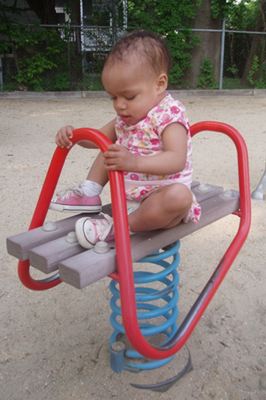
Data Quality Issues: C4
Survey methodology issues
  Response rates
  Representative results
  Response bias
  Reliability and validity of the survey tool

Slide 16
What can these data tell us?
Can illustrate comparative differences among subgroups within the state
Generalize within population surveyed
Generalize within response pool (e.g. region, race/ethnicity)
Reporting helpfulness of the program, not family capacity or true outcomes

Slide 17
Cautions in Interpretation: C4
Helpfulness to the Family ≠ Family Outcomes
Consider methodological difference when making comparisons to other states
Consider who is missing from your data- who do your data really represent?
Consider your scoring metric in interpreting percentages

Slide 18
Solutions & Suggestions: C4
Use comparison data matching your population exactly
Use data analysis techniques like weighting
Use your other survey data (beyond Indicator 4)
Use other family data collection modalities to inform program improvement

Slide 19
Early childhood outcomes:
Indicators c3 & b7

Slide 20
Indicator C3: Percent of infants-toddlers with improved outcomes
Indicator B7: Percent of preschool children with improved outcomes

Slide 21
Which Questions?
How well do our children perform on an assessment?
How much progress are our children making? Over what time period?
Are instructors doing a good job teaching our children?
Are programs doing a good job teaching our children?
Is our state doing a good job teaching our children?
How well is our state doing compared to another state?

Slide 22
Comparing Programs
LOW CHILD OUTCOMES
HIGH CHILD OUTCOMES

Slide 23
preschool settings:
Part b indicator 6

Slide 24

Indicator B 6
Educational Environments 3-5
Where do children ages 3-5 attend and receive IDEA services?
Snapshot of environment
  All children ages 3-5
  Point in time
  October 1- December 1
  Includes children aged 5 in kindergarten

Slide 25
Coding - Computer vs. People
Computer uses IEP fields and determines appropriate code
People use their knowledge and/or tools to determine the appropriate code
What might the differences be
if using varied collection systems?

Slide 26

Indicator B 6
Educational Environments 3-5
Where do children ages 3-5 attend and receive IDEA services?
Preschool? or Kindergarten?
Which program?

Slide 27

Indicator B 6
Educational Environments 3-5
Data can NOT be disaggregated by
  Preschool or kindergarten setting in 618 data collection
Data can NOT identify specific program in 618 data collection
  State pre-k, Head Start, child care, other
  Requires additional state data

Slide 28
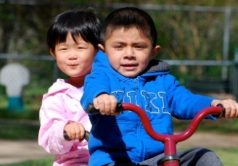
Indicator B 6
Educational Environments 3-5
Can be disaggregated by
  Age
  Race - Ethnicity
  Disability Category
  English Language Learner status

Slide 29
Educational Environments Ages 3-5, December 1, 2013
All Children 3-5 Including 5 year olds in Kindergarten
Indicator 6 -- Percent of Children

Slide 30
Educational Environments Ages 3-5, December 1, 2013
All Children 3-5 Excluding Children in Kindergarten Compared to Kindergarten Only -- Percent of Children

Slide 31
Looking Across Settings

Slide 32
Disproportionality:
Part b Indicators 9 & 10

Slide 33
States and Territories Must Report
B9. Percent of districts with disproportionate representation of racial and ethnic groups in special education and related services that is the result of inappropriate identification; and
B10. Percent of districts with disproportionate representation of racial and ethnic groups in specific disability categories that is the result of inappropriate identification.

Slide 34
Question 1: Disproportionality?
For each district in your state…
Are students from some racial/ethnic groups of students more (or less) likely to be identified for special education services than other students?
… for services in any of these particular categories?
  ED, SLI, ID, Autism, OHI, SLD

Slide 35
Question 2: Inappropriate Identification?
If so, is it the result of inappropriate policies, practices, and procedures?

Slide 36
How do States Measure Disproportionality?
Differently
Mostly starts with risk:
  # of students with disabilities in racial/ethnic group
  # of enrolled children in racial/ethnic group
Risk ratio, alternate risk ratio, weighted risk ratio…
OR e-formula, composition difference, # affected…
OR some combination
Notes:
In 2012-13, 45 of 52 States used the risk ratio, 7 of these in combination with another method

Slide 37
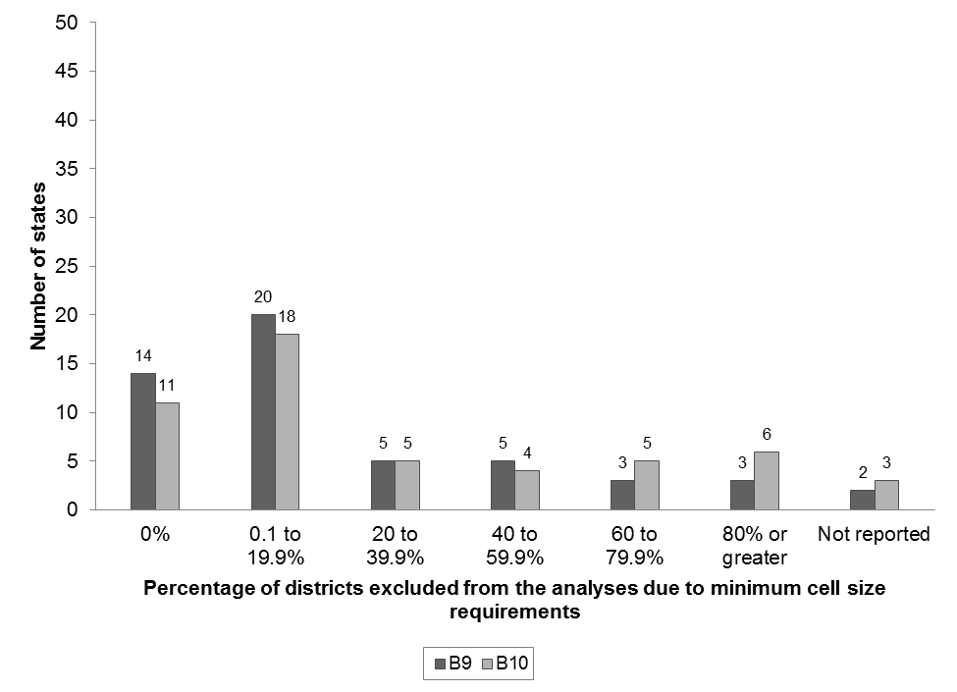
Who Counts?
Sampling Frames at the District Level
Notes:
No sampling; all students included; many smaller groups excluded.

Slide 38
Data Collection and Data Entry
Fairly solid.
These are official counts of students with and without disabilities.

Slide 39
Data Preparation and Analysis:
Check your work!
Are your formulas accurate? Do the numbers look reasonable?
  For example, remember that an overrepresentation of one group usually has to be balanced by an underrepresentation of another group

Slide 40
Data Preparation and Analysis:
Thresholds
Disproportionate Representation is defined as a risk ratio that exceeds the state threshold
Thresholds vary from state to state!
  3.0 for 16 states
  2.0 for 10 states

Slide 41
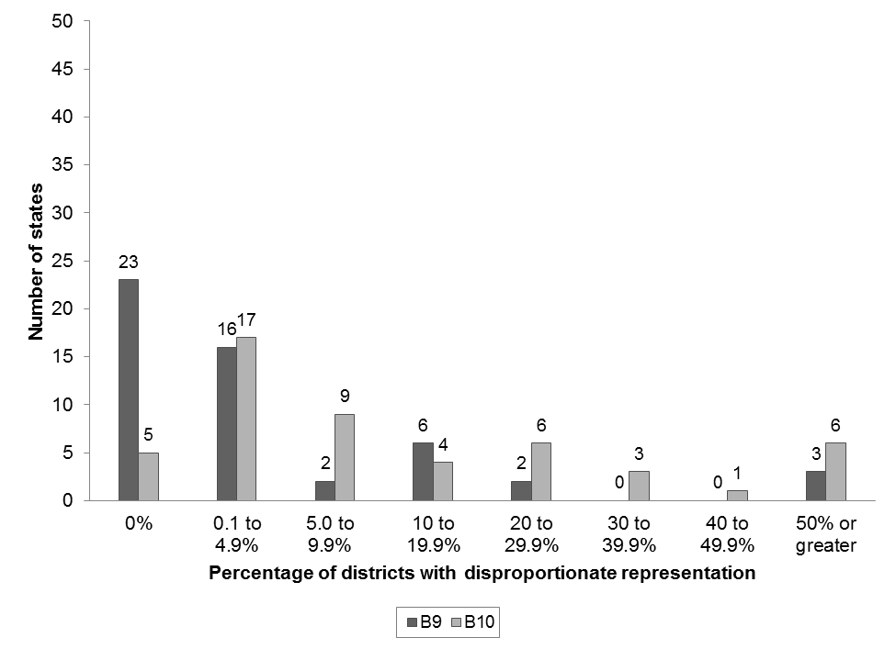
Percent of Districts with Disproportionate Representation

Slide 42
Interpretation
Is zero a sign of no problem in the state?
Or
Is it the result of state analysis choices?

Slide 43
Data Preparation and Analysis:
Inappropriate Identification
Some states look very narrowly at what constitutes inappropriate policies, practices, and procedures. Was there an obvious, documented, lack of compliance?
A broader conception is possible – see, for example, IDC’s Success Gaps documents. Appropriate identification begins in general education!

Slide 44
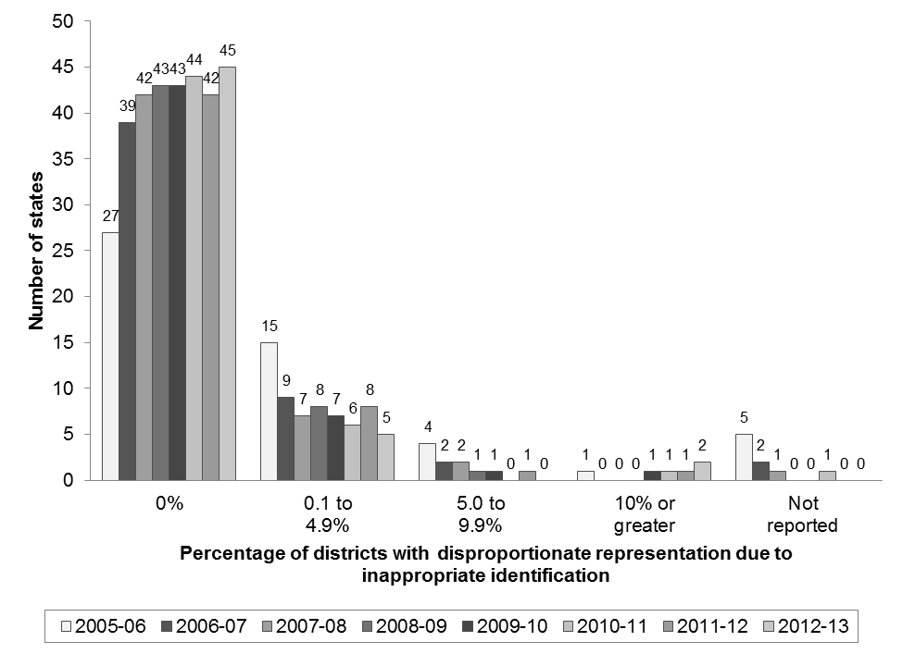
Number of States Reporting Various Percentages of
Districts with Disproportionate Representation
That Was the Result of Inappropriate Identification for B9:
2005–06 Through 2012–13

Slide 45
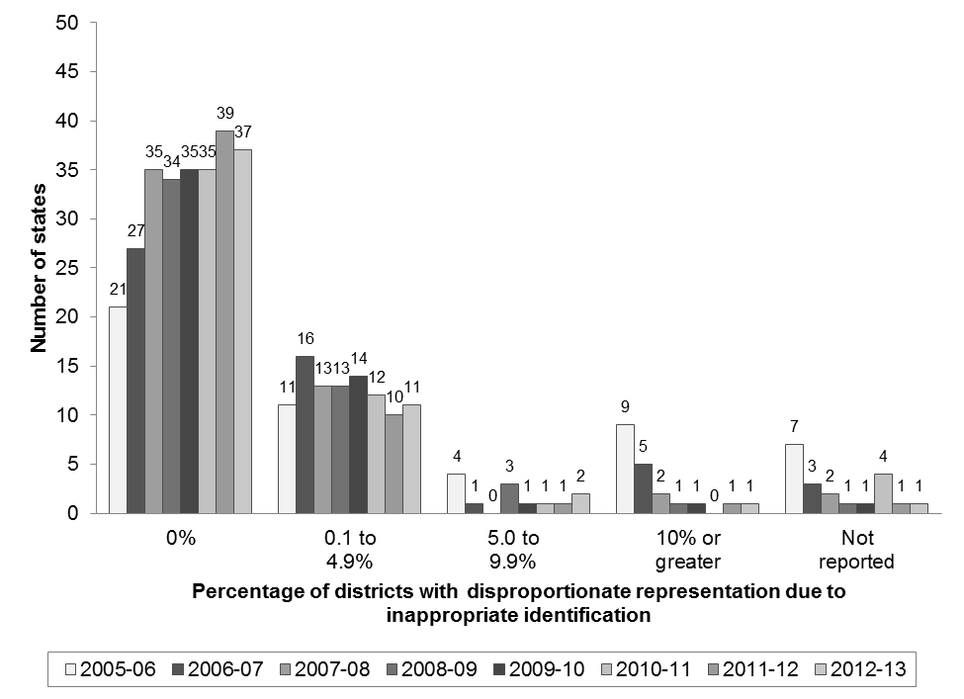
Number of States Reporting Various Percentages of
Districts with Disproportionate Representation that was the Result of Inappropriate Identification for B10: 2005–06 Through 2012–13

Slide 46
Interpretation
Is zero a sign of no problem in the state?
Or
Is it the result of state analysis choices?

Slide 47
Elements of an Appropriate Identification
Did the overrepresented group have access to high quality
  Data-based decision making
  Cultural responsiveness
  Strong core instructional program
  Universal screening and progress monitoring
  Multi-tiered interventions and supports
With strong parent involvement throughout?

Slide 48
What Can We Say?
Districts that are identified with disproportionate representation should look very closely at the reasons behind the numbers, using a tool like the Success Gaps tool

Slide 49
What Can’t We Say:
Limits of Interpretation
States with fewer districts identified have less disproportionality.
States with fewer districts identified have less inappropriate identification.
Until the methods are standardized, don’t compare indicator B9 and B10 results across states.

Slide 50
Discussion Questions
 What’s the difference between child outcomes and program performance?
 Can your data tell you which states, districts, or programs are performing better?
 What policy questions would you like to know about that your data cannot currently give you answers to?

Slide 51

Comments or Questions?

Slide 52

For More Information
Visit the IDC website
http://ideadata.org/
Follow us on Twitter
https://twitter.com/ideadatacenter

Slide 53

Grant Information
The contents of this presentation were developed
under a grant from the U.S. Department of Education, #H373Y130002. However, the contents do not necessarily represent the policy of the Department of Education, and you should not assume endorsement by the Federal Government.
Project Officers: Richelle Davis and Meredith Miceli

